Slide 1
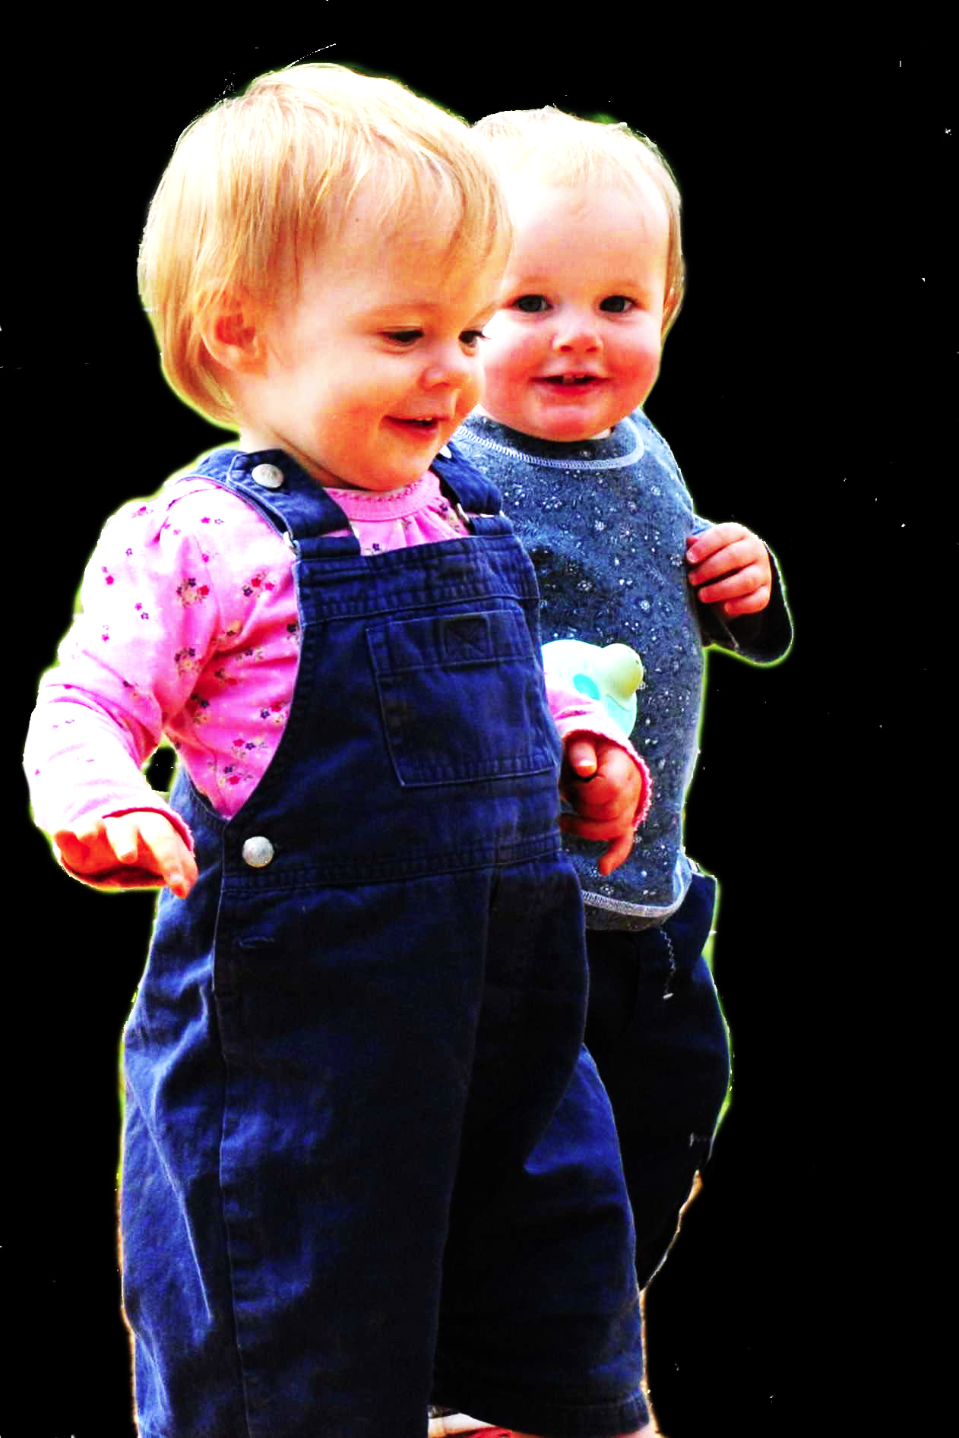
challenge
Explain the emergence, in evolution or development, of sophisticated forms of theory of mind cognition.
conjecture
The existence of abilities to engage in joint action partially explains how sophisticated forms of theory of mind cognition emerge in evolution or development (or both)
first objection
Sophisticated forms of theory of mind cognition emerge before joint action

Slide 2
Theory of mind abilities are widespread

Slide 3
Theory of mind abilities are widespread
18-month-olds point to inform, and predict actions based on false beliefs
(Liszkowski et al 2006)
(Onishi & Baillargeon 2005; Southgate et al 2007)

Slide 4
Theory of mind abilities are widespread
18-month-olds point to inform, and predict actions based on false beliefs
Scrub-jays selectively re-cache their food in ways that deprive competitors of knowledge of its location
(Liszkowski et al 2006)
(Onishi & Baillargeon 2005; Southgate et al 2007)
(Clayton, Dally & Emery 2007)

Slide 5
Theory of mind abilities are widespread
18-month-olds point to inform, and predict actions based on false beliefs
Scrub-jays selectively re-cache their food in ways that deprive competitors of knowledge of its location
Chimpanzees conceal their approach from a competitor’s view, and act in ways that are optimal given what another has seen
(Liszkowski et al 2006)
(Onishi & Baillargeon 2005; Southgate et al 2007)
(Clayton, Dally & Emery 2007)
(Hare, Call & Tomasello 2006)
(Hare, Call & Tomasello 2001)

Slide 6
Theory of mind abilities are widespread
18-month-olds point to inform, and predict actions based on false beliefs
Scrub-jays selectively re-cache their food in ways that deprive competitors of knowledge of its location
Chimpanzees conceal their approach from a competitor’s view, and act in ways that are optimal given what another has seen
(Liszkowski et al 2006)
(Onishi & Baillargeon 2005; Southgate et al 2007)
(Clayton, Dally & Emery 2007)
first objection
(Hare, Call & Tomasello 2006)
Sophisticated theory of mind cognition emerges before joint action
(Hare, Call & Tomasello 2001)

Slide 7
Theory of mind abilities are widespread
18-month-olds point to inform, and predict actions based on false beliefs
Scrub-jays selectively re-cache their food in ways that deprive competitors of knowledge of its location
Chimpanzees conceal their approach from a competitor’s view, and act in ways that are optimal given what another has seen
(Liszkowski et al 2006)
(Onishi & Baillargeon 2005; Southgate et al 2007)
(Clayton, Dally & Emery 2007)
first objection
(Hare, Call & Tomasello 2006)
Sophisticated theory of mind cognition emerges before joint action
(Hare, Call & Tomasello 2001)

Slide 8
Theory of mind abilities are widespread
18-month-olds point to inform, and predict actions based on false beliefs
Scrub-jays selectively re-cache their food in ways that deprive competitors of knowledge of its location
Chimpanzees conceal their approach from a competitor’s view, and act in ways that are optimal given what another has seen
(Liszkowski et al 2006)
(Onishi & Baillargeon 2005; Southgate et al 2007)
(Clayton, Dally & Emery 2007)
(Hare, Call & Tomasello 2006)
(Hare, Call & Tomasello 2001)

Slide 9
Theory of mind abilities are widespread
18-month-olds point to inform, and predict actions based on false beliefs
Scrub-jays selectively re-cache their food in ways that deprive competitors of knowledge of its location
Chimpanzees conceal their approach from a competitor’s view, and act in ways that are optimal given what another has seen
Representing perceptions, knowledge states and beliefs is hard

Slide 10
Theory of mind abilities are widespread
18-month-olds point to inform, and predict actions based on false beliefs
Scrub-jays selectively re-cache their food in ways that deprive competitors of knowledge of its location
Chimpanzees conceal their approach from a competitor’s view, and act in ways that are optimal given what another has seen
Representing perceptions, knowledge states and beliefs is hard, for it requires
(a) conceptual sophistication
- takes years to develop
- development tied to acquisition of executive function and language
- development facilitated by training and siblings

Slide 11
Theory of mind abilities are widespread
18-month-olds point to inform, and predict actions based on false beliefs
Scrub-jays selectively re-cache their food in ways that deprive competitors of knowledge of its location
Chimpanzees conceal their approach from a competitor’s view, and act in ways that are optimal given what another has seen
Representing perceptions, knowledge states and beliefs is hard, for it requires
(a) conceptual sophistication
- takes years to develop
- development tied to acquisition of executive function and language
- development facilitated by training and siblings
(b) scarce cognitive resources
- attention
- working memory

Slide 12
Theory of mind abilities are widespread
18-month-olds point to inform, and predict actions based on false beliefs
Scrub-jays selectively re-cache their food in ways that deprive competitors of knowledge of its location
Chimpanzees conceal their approach from a competitor’s view, and act in ways that are optimal given what another has seen
Representing perceptions, knowledge states and beliefs is hard, for it requires
(a) conceptual sophistication
- takes years to develop
- development tied to acquisition of executive function and language
- development facilitated by training and siblings
(b) scarce cognitive resources
- attention
- working memory

Slide 13
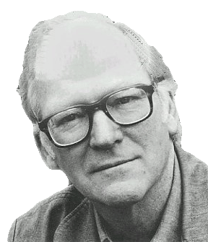
“We are stuck with our two main ways of describing and explaining things, one which treats objects and events as mindless, and the other which treats objects and events as having propositional attitudes. I see no way of bridging the gap”
(Davidson 2003: 697)

Slide 14
“We are stuck with our two main ways of describing and explaining things, one which treats objects and events as mindless, and the other which treats objects and events as having propositional attitudes. I see no way of bridging the gap”
(Davidson 2003: 697)

Slide 15
Propositional attitude
Relational attitude

Slide 16
Propositional attitude
Relational attitude
e.g. believes that ...
e.g. knows that ...
e.g. excited by ...
e.g. engaged in ...

Slide 17
Propositional attitude
Relational attitude
e.g. believes that ...
e.g. knows that ...
e.g. excited by ...
e.g. engaged in ...
arbitrarily nestable contents
no contents
uncodifiably complex effects on action
parameter-setting effects on action
permit mistakes about identity and existence
enable tracking limited range of true and false beliefs

Slide 18
challenge
Explain the emergence, in evolution or development, of sophisticated forms of theory of mind cognition.
conjecture
The existence of abilities to engage in joint action partially explains how sophisticated forms of theory of mind cognition emerge in evolution or development (or both)
first objection
Sophisticated theory of mind cognition emerges before joint action

Slide 19
challenge
Explain the emergence, in evolution or development, of sophisticated forms of theory of mind cognition.
conjecture
The existence of abilities to engage in joint action partially explains how sophisticated forms of theory of mind cognition emerge in evolution or development (or both)

